Slide 1
Handling Questions + Some Other Stuff ENG 100E Pamela Cosman

Slide 2
Know Your Audience
You are nearly always the room’s biggest expert in your topic
Potential audiences:
Colleagues & collaborators
Non-collaborating topic experts
Technical non-experts
Technically-minded non-scientist/engineers
Non-technically minded non-scientists/engineers
Friends and family
(slides 2,4,5 adapted from Prof. Darren Lipomi’s IDEA – GRAD talk)
2

Slide 3
Know Your Audience
Two possible mistakes:
You talk below the level of the audience ➔ they are bored
You talk above the level of the audience ➔ they are lost
Which is more common?
Aim for 1-2 steps below what you think your audience is
3

Slide 4
The Curse of Knowledge
It doesn’t occur to the speaker that the audience doesn’t know what she/he knows
3-year old sees toy hidden while 2nd child is out of room:
thinks other child will look for it in its actual location rather than where she/he last saw it!
We think this way too!
4

Slide 5
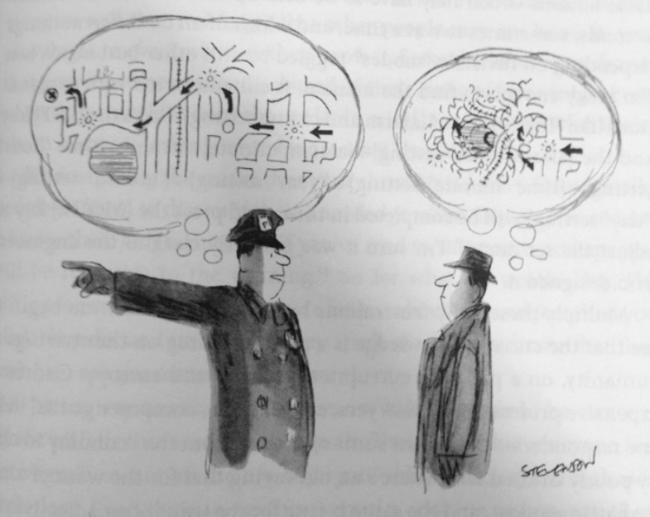
The Curse of Knowledge
5

Slide 6
Face the Audience
Not the screen
Look briefly at the screen when you need to point to something on it
6

Slide 7
Pointers & Microphones
Use the pointer to point directly at the item
Don’t circle around with it
Use a microphone if available
Check the distance from mouth (ask audience if they can hear)
Common mistakes:
Using the microphone as a pointer
Moving the microphone closer and farther away from your mouth
Turning your head to look at the screen
7

Slide 8
Handling Questions
What to do when:
the question is irrelevant?
there’s just too many questions?
you don’t know the answer?
Basic responses to these:
Great question! Let’s discuss that after the talk
Let’s hold remaining questions for the end
I need to think about that and I’ll get back to you
I’ve been paying a lot of attention to the pattern of questions & interruptions in recent years
Speakers may need to limit questions

Slide 9
Research on Interruptions in Conversation
Many contexts studied:
Groups with different gender composition, status
Corporations, press briefings, Supreme Court oral arguments, doctor-patient, fictional TV, …
Interruptions indicate power & dominance
Gender and status effects
Men & high status people interrupt more often
However, depends on the situation…. many effects:
Group composition matters
Supportive vs. non-supportive interruptions

Slide 10
Operational Definitions of Interruptions
Simultaneous speech more than two syllables before the end of someone’s sentence
Interrupting in the midst of incomplete grammatical unit
We’re dealing with presentations, not conversations
Didn’t raise your hand; didn’t get acknowledged by the speaker ➔ interruption

Slide 11
Actually, a bit more complicated
Presenter is Presenting:
Presenter is Answering a Question:
Raise your hand, get acknowledged
ACKNOWLEDGED QUESTION
Otherwise
INTERRUPTION
Wait until the presenter has finished their answer, then ask another question without raising hand
FOLLOW-UP QUESTION
Otherwise (ask another question without letting presenter finish, speech overlap)
INTERRUPTION

Slide 12
Data Set: Video recordings of job talks
2 large public universities
Lo-W: on low end for women faculty in engr
Hi-W: on high end for women faculty in engr
Multiple departments
Both: Elec.Engr, Comp.Sci.
Lo-W: Bio.Engr., Mech.Engr.
Use all available  data
○ Select approx. 2:1 seniority matched data
140 videos
91 men, 49 women
Seniority:
PhD students: 44
1-2 years out: 26
3-4 years out: 28
5-6 years out: 12
7-21 years out: 30
Data analysis (so far) only from pre-Q&A portion of talk
✚


Slide 13
Sample Data
Female, PhD+4 | Start | End | Duration | Type
Presenting | 0:01:22 | 0:11:25 | 10:03
Question (Acknowledged) | 0:11:26 | 0:11:33 | 00:07 | Neutral
Answer | 0:11:34 | 0:11:46 | 00:12
Presenting | 0:11:47 | 0:15:40 | 03:53
Question (Interruption) | 0:15:41 | 0:15:44 | 00:03 | Neutral
Answer | 0:15:45 | 0:15:51 | 00:06
Question (Follow-up) | 0:15:51 | 0:15:54 | 00:03 | Neutral
Answer | 0:15:55 | 0:16:09 | 00:14
Question (Interruption) | 0:16:09 | 0:16:11 | 00:02 | Hostile
Answer | 0:16:12 | 0:16:18 | 00:06
Notes:
Table: Candidate starts presenting at 1min 22 sec (time before that must have been introduction), goes to 11min 25 sec.
1st question (acknowledged) comes at 11min 26sec, goes to 11min 33 sec
There’s an answer, then back to presenting. Then a question (interruption), followed by answer, and follow-up question, etc…

Slide 14
Number of Questions vs. Length of Talk

Slide 15
Results
Effect of seniority:
Both men and women interrupted less when they are more experienced
Gender effect:
Women receive more questions than men on average:
More follow-up questions
More total questions

Slide 16
Results & Data Analysis
Dependent Variables | Men | Women
 | Mean/(SD) | Mean/(SD)
Interruptions | 3.77 | 4.95
 | (4.87) | (6.21)
Ack. questions | 5.49 | 5.39
 | (4.89) | (4.07)
Follow-up Qs | 4.83 | 6.66
 | (4.76) | (7.02)
Total questions | 14.1 | 17
 | (11.6) | (13.9)
Audience time | 0.038 | 0.050
 | (0.031) | (0.038)
N talks | 78 | 41
Bioengineering is very different (not included in these numbers)

Slide 17
Results
Huge departmental effect:
81% of BE talks have zero questions
Only 9% of talks in other departments have zero questions
Huge university effect:
Men/women presenting at university Lo-W receive 240%/270% more questions than men/women at university Hi-W

Slide 18
Comments
Analysis difficulty: Zero questions because of
Departmental effects
Candidate is super clear
Train wreck
Questions can be good too
Elicit useful clarifications from the speaker
Demonstrate interest from the audience
Make the talk feel more casual and interactive

Slide 19
Number of Questions vs. Length of Talk
Some people
get hammered!
30-50 questions!

Slide 20
Suggestion I make to Departments
Not all faculty candidates are comfortable saying: “Let’s hold remaining questions for the end”
Department should have a seminar host who can step in and say it, if needed
Holistic decision based on Number/Content/Tone of questions, reaction of candidate, etc.

Slide 21
Suggestions for Speakers
Have back-up slides so you are prepared for probing questions
Practice with a knowledgeable friend who can ask good questions
If necessary, OK to say: “Let’s hold remaining questions for the end”
OK to say: I don’t know, let me get back to you
Be aware: big differences between audiences
Some aggressive groups out there
Don’t get upset… just defer to later…
you’re the speaker so you’re in charge

Slide 22
Course Details
Has everyone visited the course web site yet?
Plan to run your presentation from your own laptop
Monday: Rakesh Kumar
Wednesday:
Wenchuan
1 more
Friday:
Edan (introduced by Adina)
2 more
22

Slide 23
Today’s Word
SURMISE
Verb – to suppose that something is true without having evidence to confirm it
Noun – a supposition that something may be true, even though there is no evidence to confirm it
23

